Slide 1


Social Buzz Data Analysis

Slide 2


Today's agenda
Project recap
Problem
The Analytics team
Process
Insights
Summary

Slide 3

fffa
Client Name: Social Buzz
Industry: Social Media & Content Creation
Background: Founded by former engineers from a major social media conglomerate, focused on a content-centric platform, with 500 million active users monthly.
Challenges: Rapid growth, extensive data creation, scaling issues, IPO planning.
Mission Statement:
Accenture has initiated a 3-month Proof of Concept (POC) to address key objectives:
Conduct an audit of Social Buzz's big data practices.
Provide recommendations for a successful IPO.
Analyse and identify Social Buzz's top 5 most popular content categories.
Project Recap

Slide 4

Problem
IPO Preparation: Need guidance for a smooth Initial Public Offering.
Scaling Issues: Rapid growth outpaced resources, especially in managing data scale.
Data Best Practices: Desire to learn from large corporations on effective data handling

Slide 5



Andrew Fleming (Chief Technical Architect):
Oversees technical aspects, experienced in scaling digital platforms.
The Analytics team
Marcus Rompton (Senior Principle): Specializes in data management, crucial for handling vast and unstructured data.
Daniel Akinbankole (Data Analyst): Analysing data, identifying patterns, and proposing actionable insights.

Slide 6
Process
1
Understanding the Data
2
Data Cleaning
3
Data Modelling
4
Data Analysis
5
Uncovering Insights

Slide 7
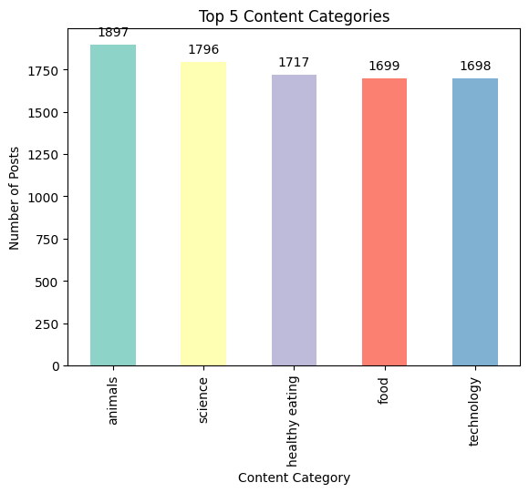
Insights
Unique Categories in the Top 5 Content are:
"Animals" is the most prevalent category with 1897 entries.
"Science" closely follows with 1796 entries.
"Healthy Eating," "Food," and "Technology" exhibit comparable counts around 1700.
The distribution reflects a balanced and diverse engagement with content.
No single category dominates, indicating a broad user interest.
Potential for targeted strategies across popular categories to enhance engagement and content creation.

Slide 8
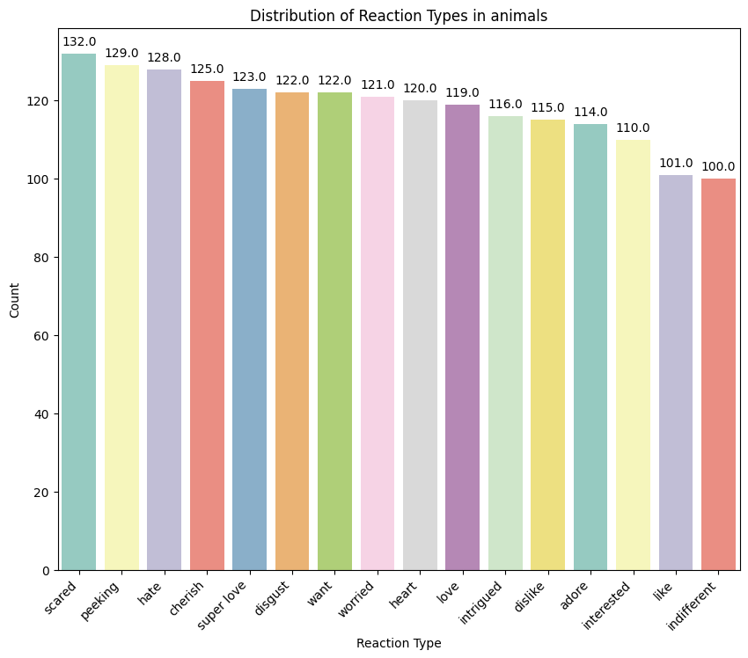
Insights
The most popular category reactions are:
"Animals" is the most popular category based on reaction.
Scared" is the most common reaction with 132 instances, followed closely by "peeking" and "hate."
Emotions like "cherish," "super love," and "disgust" also demonstrate significant engagement.
The reactions convey a diverse range of sentiments, from positive ("want," "heart," "love") to negative ("dislike," "worried," "hate").
User interactions include expressions of interest, curiosity, and emotional connections.
The distribution reflects an active and diverse community engagement with 'animals,' emphasizing the broad appeal of this category.

Slide 9
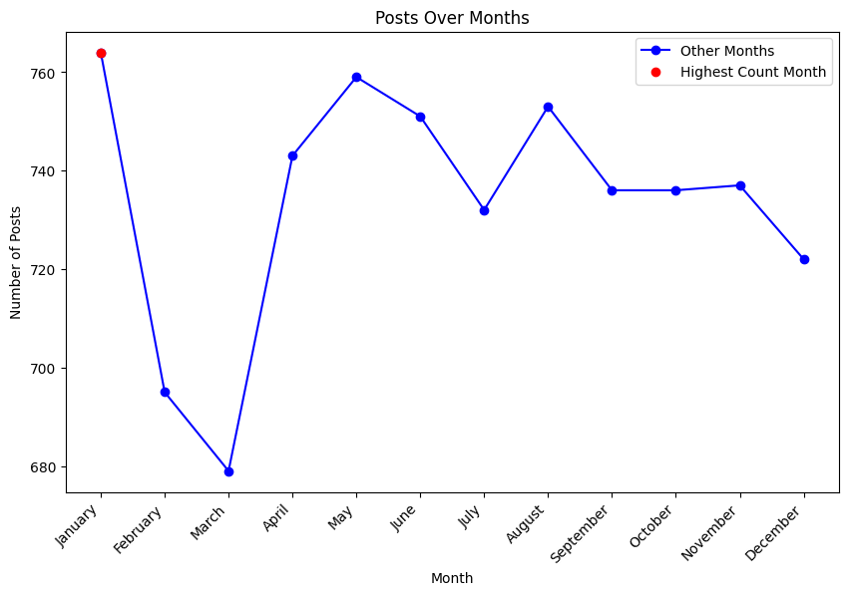
Insights
The month with the most posts is “January”, with a total of 764 posts

Slide 10


Social Buzz Data Insights:
Diverse engagement in the top 5 categories, led by 'Animals' with 1897 entries. Dominant reactions include 132 instances of 'Scared.' User connections revealed varied sentiments. Monthly activity peaks in January with 764 posts, offering strategic planning opportunities for targeted content and promotion.
Summary

Slide 11
Thank you!
ANY QUESTIONS?

